Slide 1
Team 4
Bailey Garner
Travis Hawley
Rachel Knoche
Mesegena Ysieni

Slide 2
The Game
Game Description, Details, and Rules

Slide 3
MEMORY MATCH
1-2 Players
3 Levels of Difficulty
Highest
Score Wins

Slide 4
Single Player
ONE
guess
per
available match
Select Difficulty & Rounds
Memorize Order of Images
Start Game
See Displayed Image
For
# of Rounds
Optional
See Score
End
Select Matching Images

Slide 5
Multiplayer
ONE
guess
per
available match
Select Difficulty
Memorize Order of Images
Join Session
See Displayed Image
For
10 Rounds
Optional
See Winner
End
Select Matching Images

Slide 6
SCORING
ONE Match
1000 Points
Score = % correct * 1000
75% → (.75) * 1000 = 750

Slide 7
DECIDING THE WINNER
SINGLE
MULTIPLAYER
Personal Best
Highest Score

Slide 8
Design
UML diagrams and design decisions

Slide 9
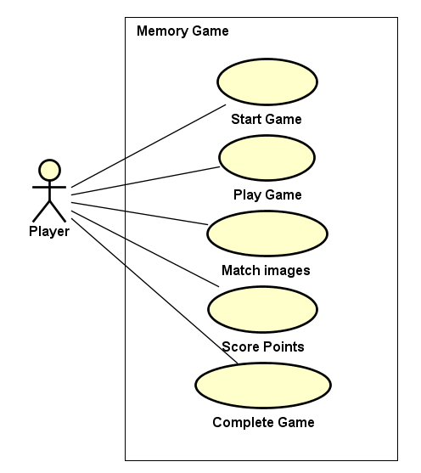
Use Case Diagram

Slide 10
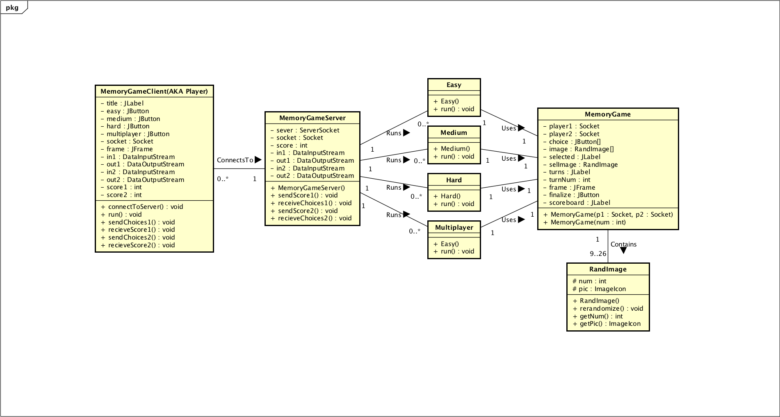
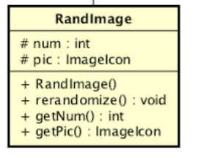
Class Diagram

Slide 11
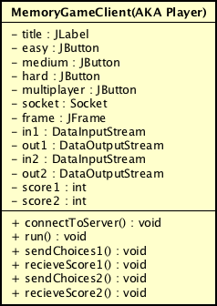
Client

Slide 12
Client Connects To Server

Slide 13
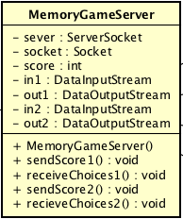
Server

Slide 14
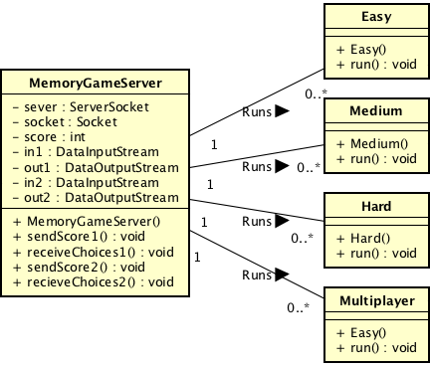
Server Runs Levels

Slide 15
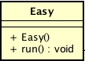
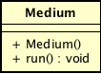
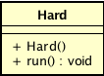
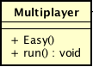
Levels of Difficulty

Slide 16
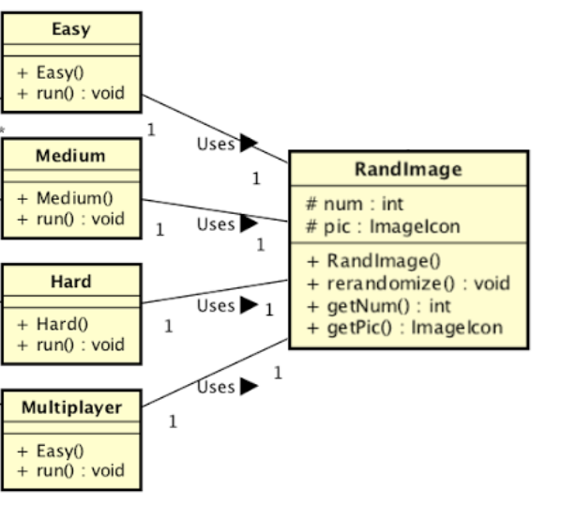
Levels Use RandImage

Slide 17
UI
User interface mockups & implementations

Slide 18
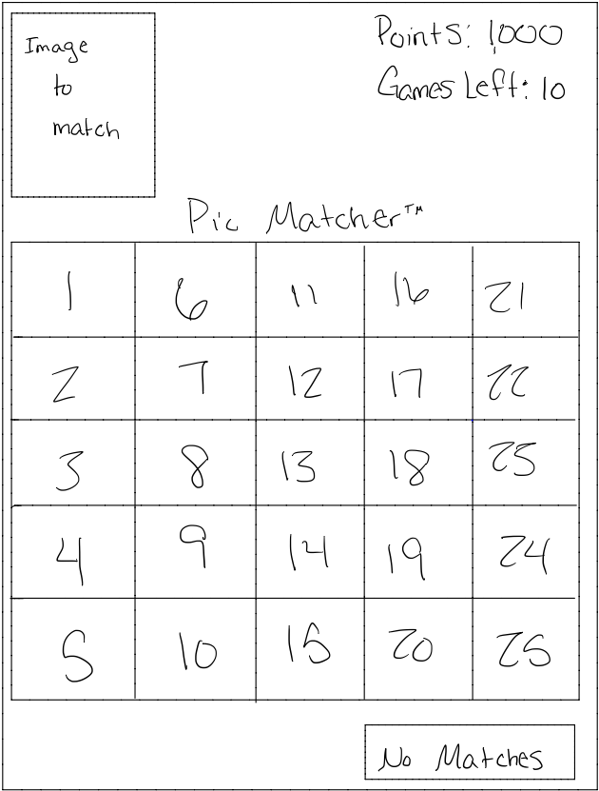
Initial UI Concept

Slide 19
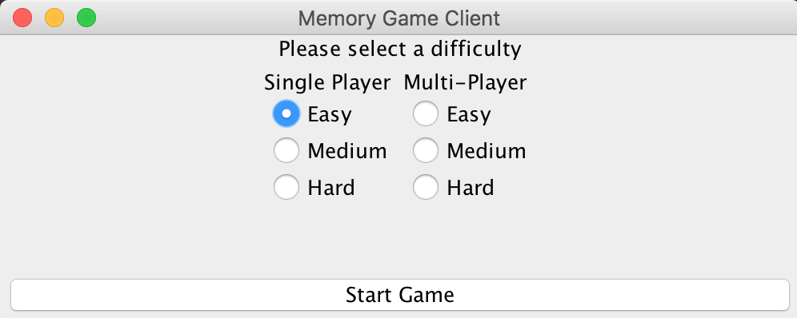
Current UI Design- Client

Slide 20





Current UI Design- Images

Slide 21
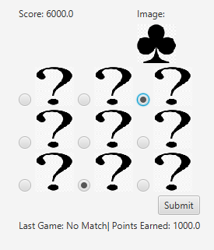
Current UI Design- Easy

Slide 22
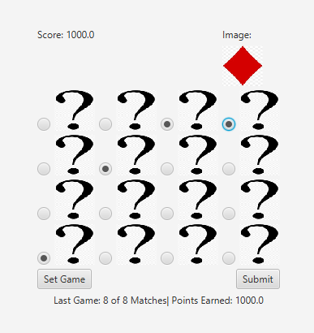
Current UI Design- Medium

Slide 23
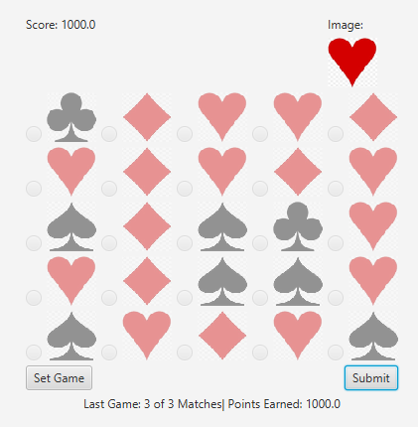
Current UI Design- Hard

Slide 24
Demonstration
A working implementation

Slide 25
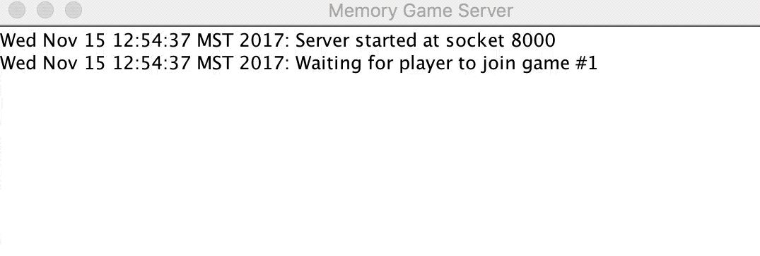
SERVER

Slide 26
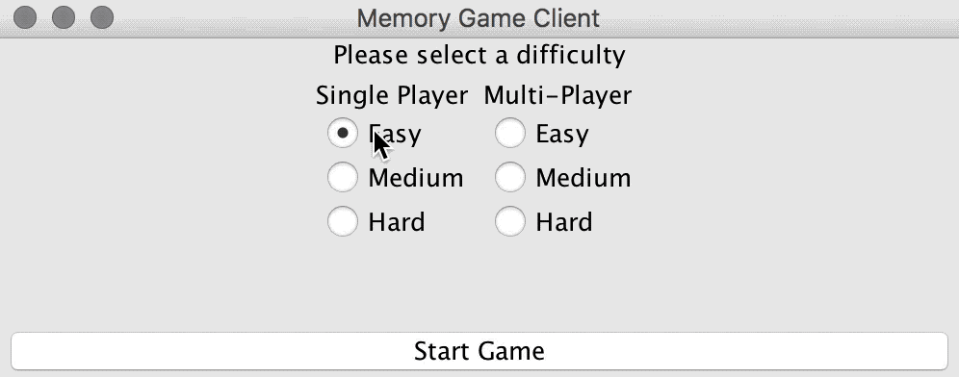
CLIENT

Slide 27
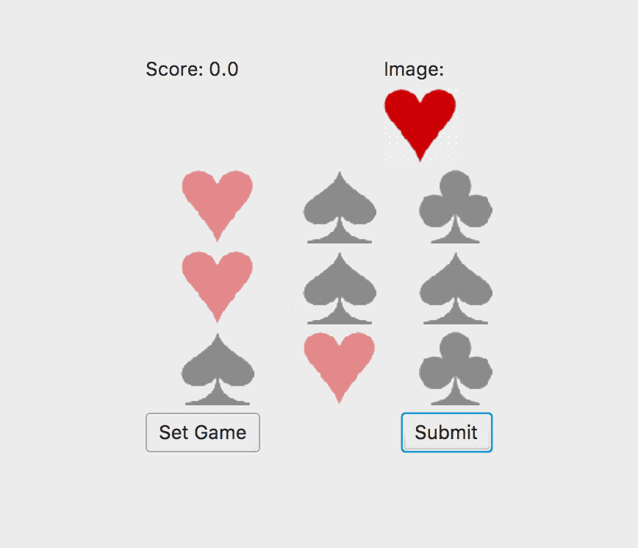
EASY - 3/3 Correct

Slide 28
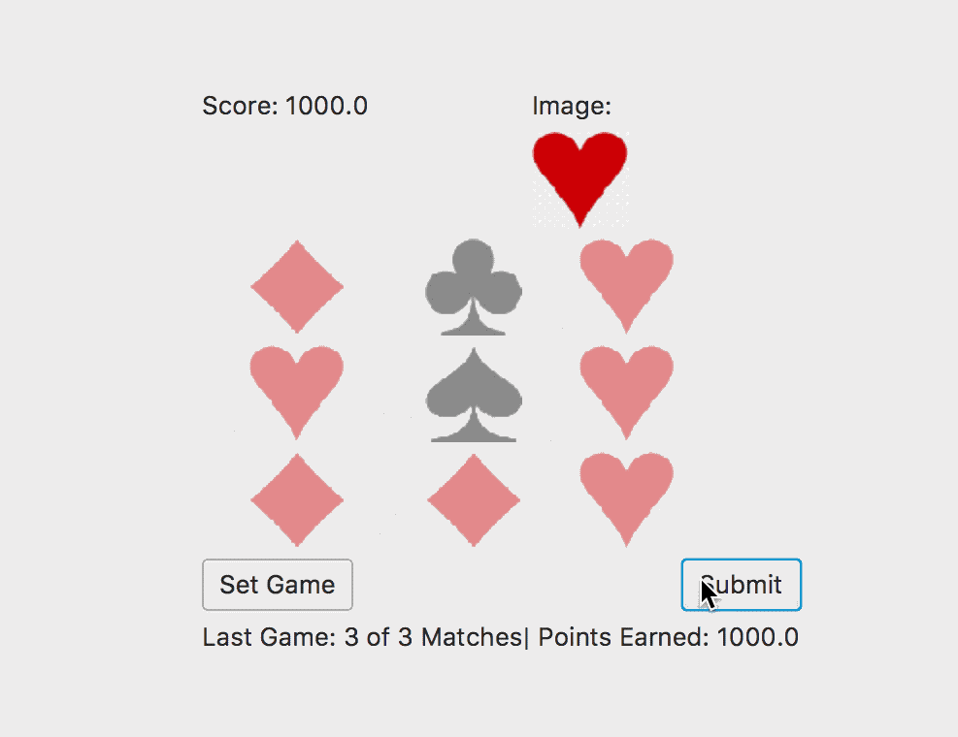
EASY - 3/4 Correct

Slide 29
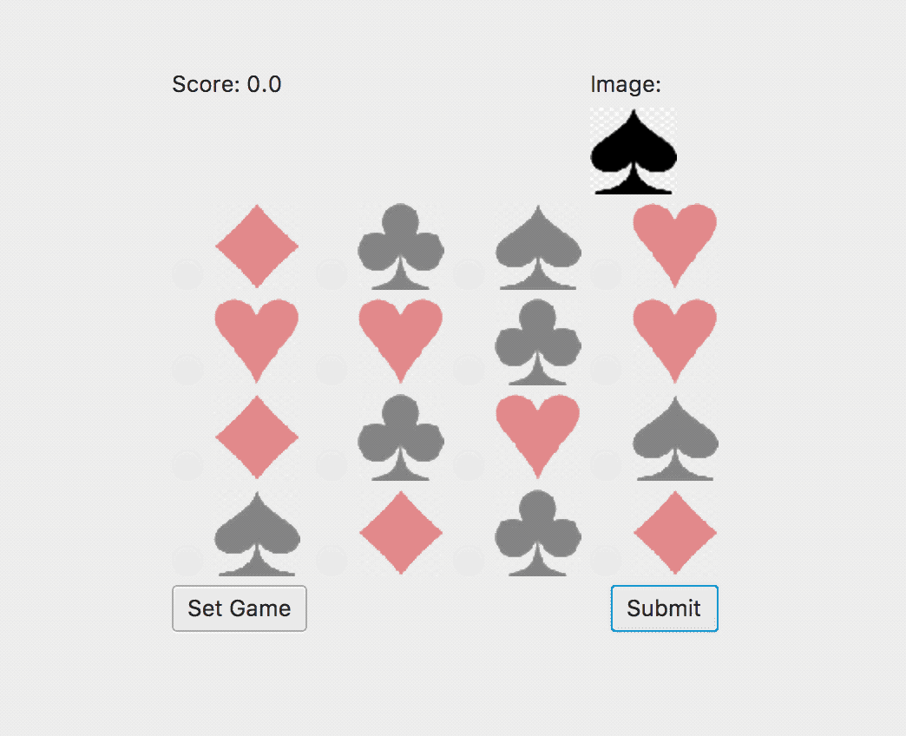
MEDIUM - 2/3 Correct

Slide 30
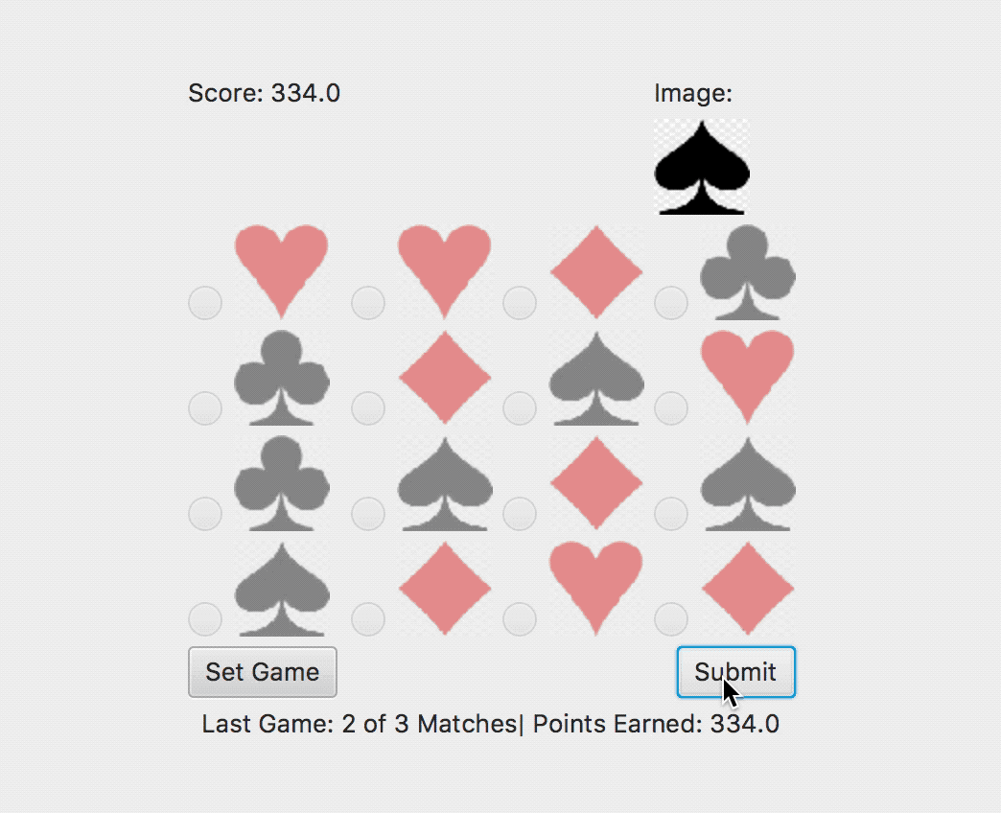
MEDIUM - 4/4 Correct

Slide 31
Roles
Roles and responsibilities

Slide 32
GUI
Travis and Mesegena

Slide 33
Server/Client
Bailey and Rachel

Slide 34
UML Diagrams
Travis and Mesegena

Slide 35
Presentation Slides
Rachel and Bailey

Slide 36
Tools
Tools used to build the project

Slide 37
TOOLS USED
UML Diagrams - Astah
Memory Game - Java
Communication - Discord
Presentation - Google Slides
Deliverables - Excel

Slide 38
Future Plans
What we hope to complete in the future

Slide 39
MULTIPLAYER

Slide 40
Thank you!
QUESTIONS?

Slide 41
CREDITS
Presentation template by SlidesCarnival

Slide 42
SlidesCarnival icons are editable shapes.
This means that you can:
Resize them without losing quality.
Change fill color and opacity.
Change line color, width and style.
Isn’t that nice? :)
Examples:

